Slide 1

HR ATTRITION ANALYSIS
KEY INSIGHTS AND RECOMMENDATIONS
BY
UWEM EFFANGA
Date: 31ST AUGUST 2024

Slide 2
INTRODUCTION
Spire Pro Integrated Limited is a Tech. company that manufactures quality hardware and software, and provides services for various fields including cloud computing, database management, ERP, customer relationship management and business intelligence. The company is experiencing high employee turnover, negatively impacting productivity, morale, and operational costs.
PURPOSE: Identifying the primary factors contributing to attrition

Slide 3
RESEARCH QUESTIONS
What impact of employee demographics on attrition rates within the company?
What are the key factors contributing to employee attrition?
How does the length of tenure affect the likelihood of an employee leaving the company?
Is there a critical tenure period after which employees are more likely to leave?
What strategies can be implemented to reduce employee turnover?

Slide 4
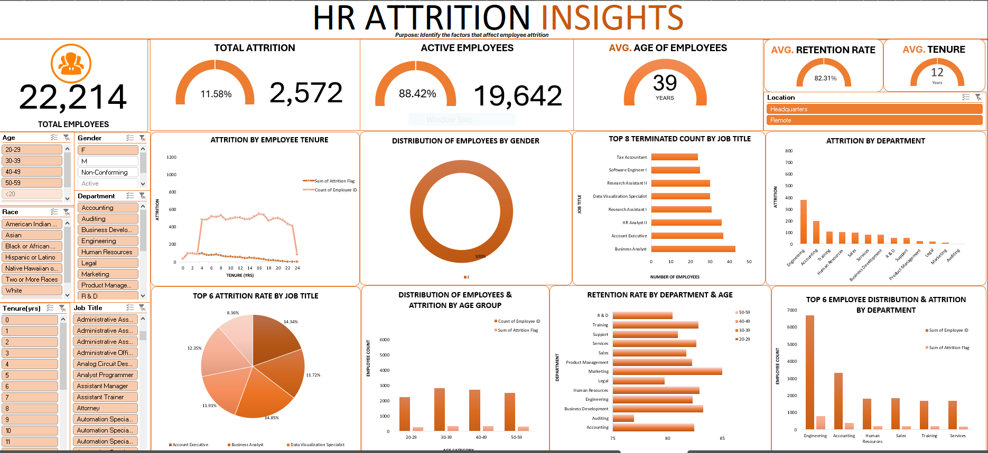
OVERVIEW OF DASHBOARD INSIGHTS

Slide 5
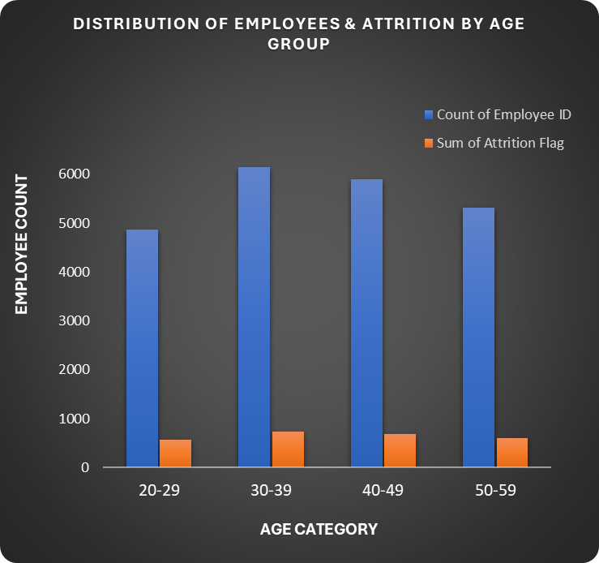
ATTRITION BY DEMOGRAPHY – AGE GROUP
KEY INSIGHTS
High Attrition rate in younger age groups
ATTRITION
Attrition is not heavily skewed towards any particular age group
RECOMMENDATION
Develop programs catering to mid-career employees.
Engagement and Recognition.

Slide 6
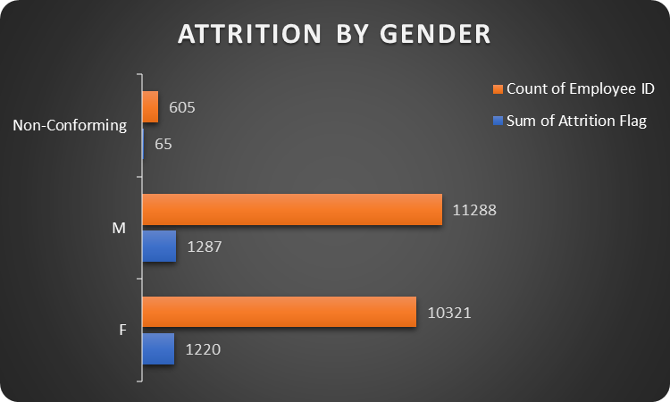
ATTRITION BY DEMOGRAPHY – GENDER
KEY INSIGHTS
51% Female, 46% Male and 3% Non-Conforming.
ATTRITION
The number of females leaving is slightly higher than males.
RECOMMENDATION
Promote diversity and inclusion programs.
Gender-Specific retention programs.

Slide 7
ATTRITION BY DEMOGRAPHY – CITY
KEY INSIGHTS
High Attrition in Cincinnati 12.98%) and Lexington (12.56%)
Low Attrition in Detroit and Philadelphia Significant Attrition in Cleveland
RECOMMENDATION
Targeted retention programs at Cleveland’s Engineering and Philadelphia’s Accounting.
Implement engagement initiatives in departments.

Slide 8
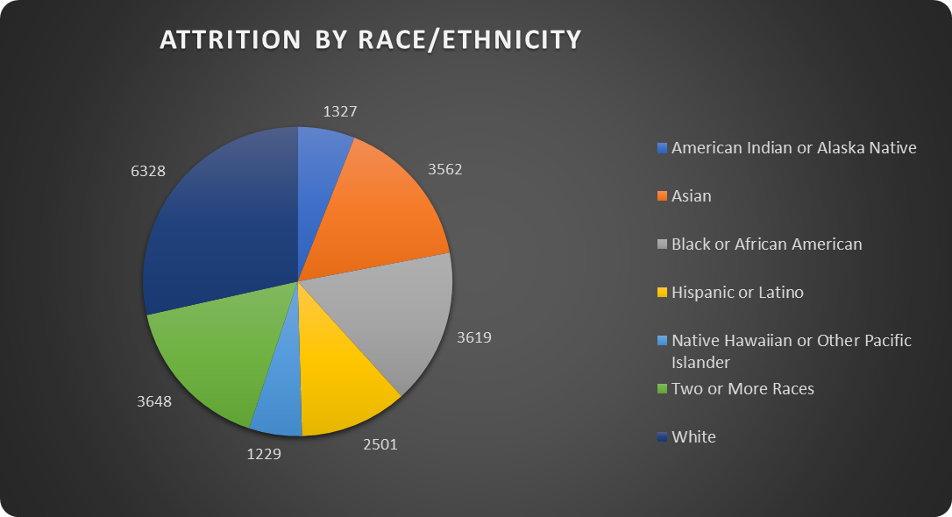
ATTRITION BY RACE/ETHNICITY
KEY INSIGHTS
High Attrition Among White Employees.
Significant Attrition in Minority Groups.
Lower Attrition in Smaller Groups.
RECOMMENDATIONS
Inclusive Workplace Policies
Employee Resource Groups
Regular Feedback and Surveys

Slide 9
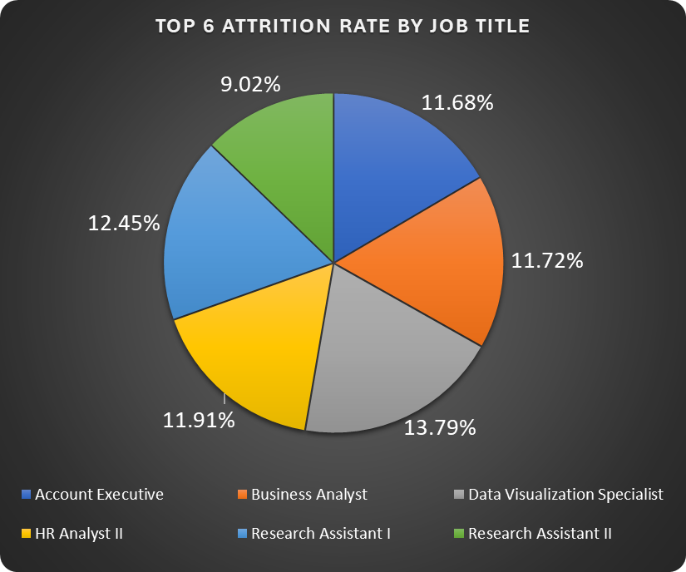
ATTRITION RATES BY JOB TITLE
KEY INSIGHTS
Data Visualisation Specialist, Human Resources Analyst II, Research Assistant I, and business analyst roles had the highest attrition rates.
RECOMMENDATION
Conduct Exit Interviews.
Regular Employee Surveys
Review career progression, workload, and management in these roles.

Slide 10
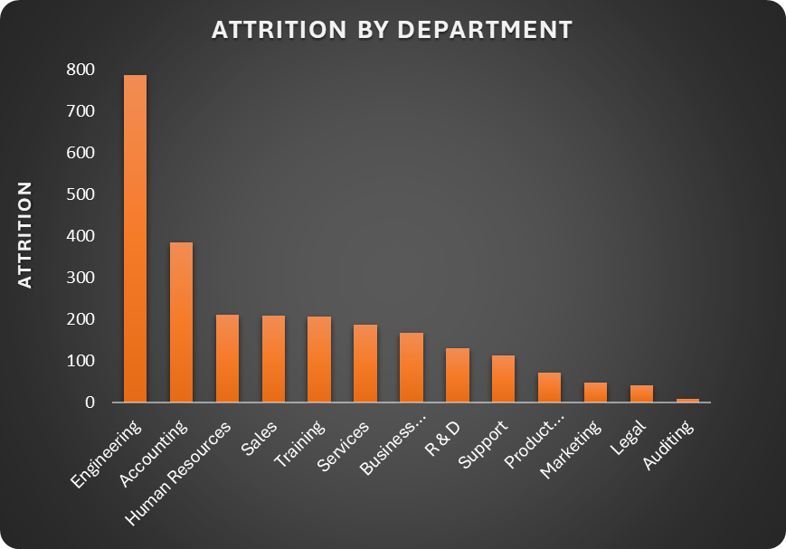
ATTRITION BY DEPARTMENT
KEY INSIGHTS
High attrition in Engineering.
Moderate attrition (Accounting and Human Resources).
Lower Attrition in Specialized departments like Auditing, Legal and Marketing.
RECOMMENDATION
Career development programs and clear progression paths to retain engineering talent.
Support HR and Accounting by employing workload management.

Slide 11
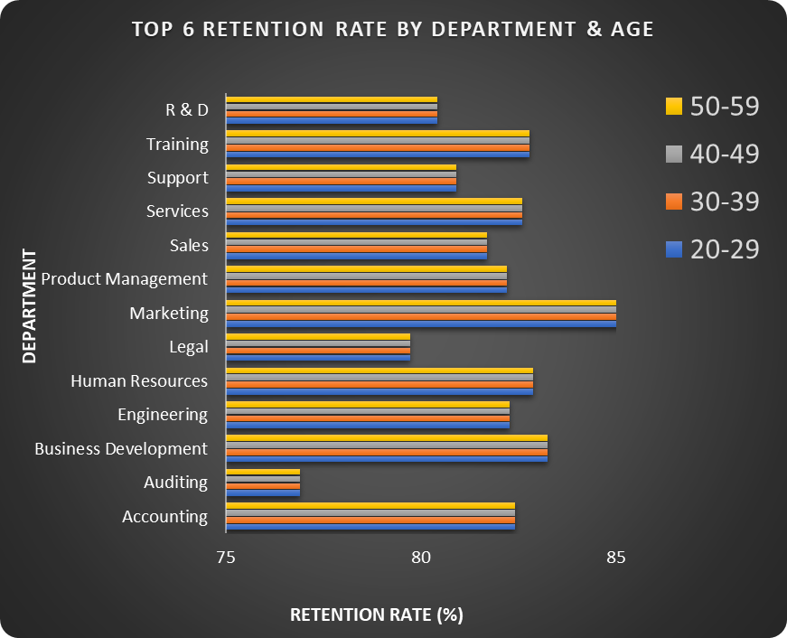
RETENTION RATE BY DEPARTMENT & AGE
KEY INSIGHTS
Marketing with the highest retention rate across all age groups, consistently at 85.43%.
Sales had lower retention rates for the 20-29 age group.
Average retention rate of 82.31%
RECOMMENDATION
Replicate successful retention practices from these departments across others.

Slide 12
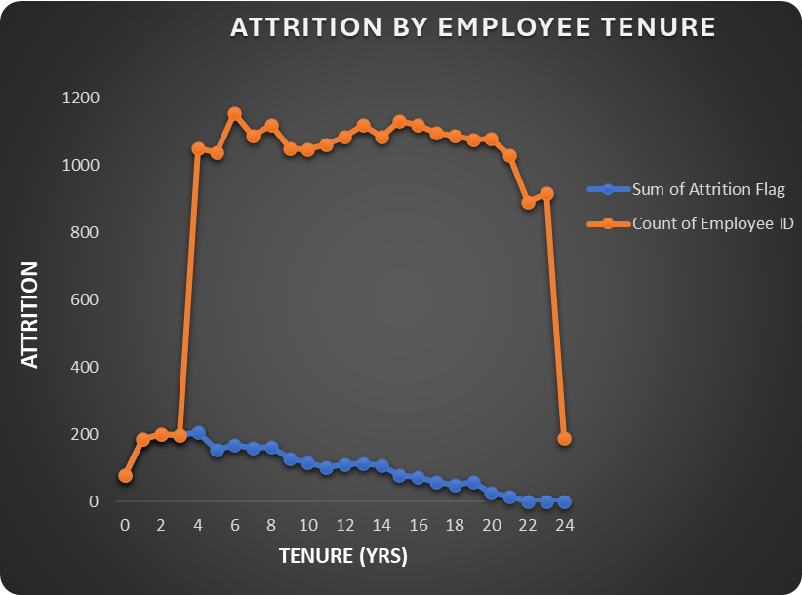
ATTRITION BY TENURE
KEY INSIGHTS
0-2 Years: High attrition rate, with a peak in the first year.
3-5 Years: Attrition rate decreases but remains significant.
6-10 Years: Further decline in attrition rate.
11-15 Years: The attrition rate stabilises at a lower level.
16+ Years: Minimal attrition, indicating long-term employee retention.
RECOMMENDATION
Onboarding and Training Programs for new employees.
Mentorship and support for employees in early tenure years.
Career development for mid-tenure employees.

Slide 13
CONCLUSION
Based on the analysis, several key factors impacting employee attrition have been identified:
a) Location-Based Attrition
b) Department-Based Attrition
Focus on departments and roles with high attrition.
Target age groups and tenure ranges for retention.
Address department-specific issues to reduce turnover

